Slide 1
Conversational SIEM Assistant for Investigation and Automated Threat Reporting using NLP
CSE7302- University project
Review-2
Batch Number:CBD_3
Roll Number | Student Name
20221CBD0012 | POOJITHA N
20221CBD0014 | PAVANI S
20221CBD0030 | UMESH S
Under the Supervision of,
Ms.Dhannya J
Professor
School of Computer Science and Engineering
Presidency University
Name of the Program: B .Tech
Name of the HOD : Dr. Pravinthraja S
Name of the Program Project Coordinator: Dr. H M Manjula
Name of the School Project Coordinators: Dr. Sampath A K , Dr. Geetha A

Slide 2
Problem Statement Number: 25173
Organization:Indian space Research Organisation(ISRO)
Category (Hardware / Software / Both) :Software
Problem Description:
ELK-based SIEMs such as Elastic SIEM and Wazuh provide powerful log collection, correlation, and detection capabilities. However, effective interaction with these systems requires

Slide 3
Content
Problem Statement
Objectives
Background and Related work for title Selection
Analysis of Problem Statement
Innovation or Novel Contributions
Git-hub Link
Timeline of the Project
References

Slide 4
Objectives :
To develop a conversational SIEM assistant that allows users to interact with security data using natural language queries.
To analyze and process SIEM logs for effective detection and investigation of security threats.
To apply Natural Language Processing techniques to understand user queries and retrieve relevant security insights.
To automate threat analysis and generate meaningful security reports.
To reduce analyst workload and improve incident response time in cybersecurity operations.

Slide 5
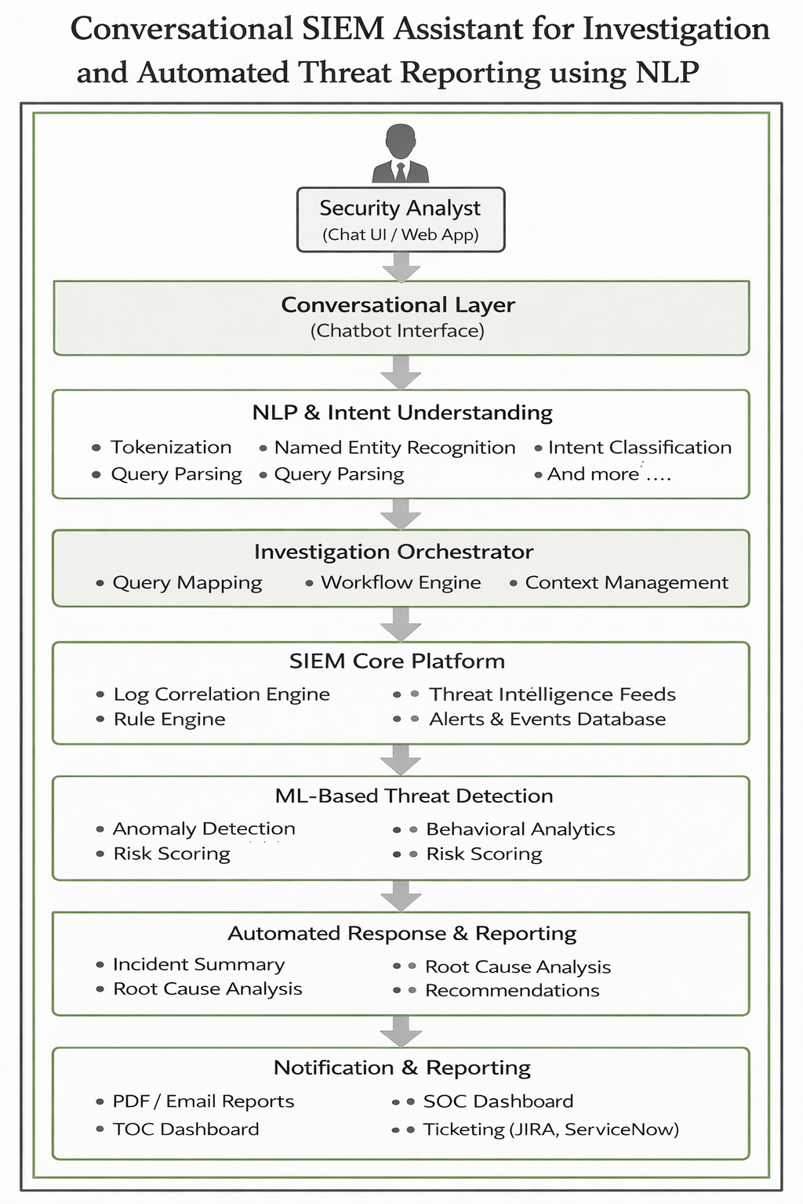
Architecture Diagram

Slide 6
Background and Related Work
Rapid growth of digital infrastructure has resulted in a massive increase in security log data, making manual analysis through traditional SIEM systems difficult and time-consuming.
Conventional SIEM platforms require complex query writing and manual dashboard interpretation, demanding advanced technical expertise and leading to slower incident response times.
Machine learning and rule-based log correlation techniques help automate threat detection but still lack intuitive interaction and contextual understanding for analysts.
NLP-based interfaces and chatbots allow users to query and analyze security logs using natural language, improving accessibility, but many existing solutions are limited and lack real-time investigation features.
The proposed Conversational SIEM Assistant combines NLP-driven interaction with SIEM log analysis and automated threat reporting to reduce analyst workload and provide actionable insights efficiently.

Slide 7
Analysis of Problem Statement
The rapid increase in security log data from diverse sources makes manual investigation in traditional SIEM systems inefficient and error-prone.
Existing SIEM platforms require complex query languages and expert knowledge, increasing analyst workload and slowing incident response.
Machine learning and rule-based detection improve alert generation but lack intuitive interaction and contextual explanation for analysts.
Current NLP-based SIEM solutions are limited in scope, often lacking real-time investigation and automated reporting capabilities.
There is a need for a Conversational SIEM Assistant that uses NLP to simplify investigations, provide contextual insights, and automate threat reporting.

Slide 8
Analysis of Problem Statement (contd...)
Software and Hardware Requirements:
Operating System: Windows 10/11 or Linux (Ubuntu 20.04 or later)
Programming Language: Python (for NLP, ML, and backend logic)
SIEM Platform: ELK Stack (Elasticsearch, Logstash, Kibana) or Splunk
NLP Frameworks/Libraries: spaCy, NLTK, Hugging Face Transformers
Machine Learning Libraries: Scikit-learn, TensorFlow or PyTorch
Backend Framework: Flask or Django
Database: Elasticsearch / MongoDB / PostgreSQL
Frontend (Optional): HTML, CSS, JavaScript, React
API & Integration Tools: REST APIs, JSON
Deployment Environment: Docker, Kubernetes (optional)

Slide 9
SDG Mapping
SDG 9 – Industry, Innovation and Infrastructure
Enhances digital security infrastructure through NLP-driven automation. Supports innovation in cybersecurity monitoring and incident response.
SDG 16 – Peace, Justice and Strong Institutions
Improves cyber threat detection and investigation. Strengthens trust, transparency, and resilience of digital institutions.
SDG 4 – Quality Education
Simplifies cybersecurity analysis using conversational interfaces. Supports learning and skill development for students and junior security analysts.
SDG 8 – Decent Work and Economic Growth
Reduces analyst workload through automation. Improves productivity and ensures secure digital environments for businesses.
SDG 17 – Partnerships for the Goals
Encourages integration of NLP, machine learning, and SIEM platforms. Promotes collaboration between academia, industry, and cybersecurity stakeholders.

Slide 10
Github Link
The Github link provided should have public access permission.
Github Link:
https://github.com/samidisettypavani/Batch_CBD03_Conversational SIEM Assistant for Investigation and Automated Threat Reporting using NLP

Slide 11
Timeline of the Project (Gantt Chart)
Phase | Week 1 | Week 2 | Week 3 | Week 4 | Week 5 | Week 6 | Week 7 | Week 8
Log & Threat Data Collection | ✔ | ✔
Header Parsing & Preprocessing | ✔ | ✔ | ✔
IP Lookup & Geolocation Analysis |  | ✔ | ✔ | ✔
NLP Module Development (Intent, NER) |  |  | ✔ | ✔ | ✔
SIEM Correlation & Threat Detection |  |  |  | ✔ | ✔ | ✔
Conversational Interface Integration |  |  |  |  | ✔ | ✔
Visualization & Dashboard Development |  |  |  |  |  | ✔ | ✔
Testing & Refinement |  |  |  |  |  | ✔ | ✔
Final Reporting & Review |  |  |  |  |  |  | ✔ | ✔

Slide 12
References (IEEE Paper format)
[1] A. Shafahi, M. F. Hossain, and R. Boutaba, “Cyber Sentinel: Exploring Conversational Agents’ Role in Security Operations,” arXiv preprint arXiv:2309.16422, 2023.
[2]Y. Chen, P. Mishra, and S. Kumar, “Large Language Models for Security Operations Centers,” arXiv preprint arXiv:2403.09871, 2024.
[3]M. Rossi, L. Bianchi, and A. Verdi, “Design and Implementation of a Chatbot for the Supervision of Security Events (SIEM),” in Proc. Int. Conf. Cyber Security and Protection of Digital Services, 2023, pp. 112–118.
[4]S. T. Ahmad and K. R. Choo, “Natural Language Processing for Cybersecurity Incident Analysis,” in Proc. Int. Conf. Artificial Intelligence and Security, 2022, pp. 55–62.
[5]R. Patel and D. Nguyen, “AI-Driven ChatOps for Real-Time Security Incident Response in DevSecOps,” Int. J. Computer Techniques, vol. 12, no. 2, pp. 1–9, May 2025.
[6]A. K. Singh, P. Verma, and N. S. Rao, “Automated Threat Hunting Using Natural Language Processing on Security Logs,” IEEE Access, vol. 11, pp. 145320–145332, 2023, doi: 10.1109/ACCESS.2023.3312456.
[7]H. Husari, M. Nader, and E. Al-Shaer, “TTPDrill: Automatic and Accurate Extraction of Threat Actions from Unstructured Text,” in Proc. IEEE Symp. Security and Privacy Workshops, 2017, pp. 103–109.
[8]S. Mittal, P. K. Das, and V. K. Singh, “A Survey of AI and NLP Techniques for Cyber Threat Intelligence,” IEEE Communications Surveys & Tutorials, vol. 23, no. 4, pp. 2349–2381, 2021.
[9]A. Vaswani et al., “Attention Is All You Need,” in Proc. Adv. Neural Information Processing Systems (NeurIPS), 2017, pp. 5998–6008.
[10]N. McLaughlin, J. McCarthy, and P. O’Reilly, “Automated Security Event Triage Using Machine Learning and Natural Language Processing,” in Proc. IEEE Int. Conf. Big Data, 2020, pp. 3214–3221

Slide 13


